Slide 1
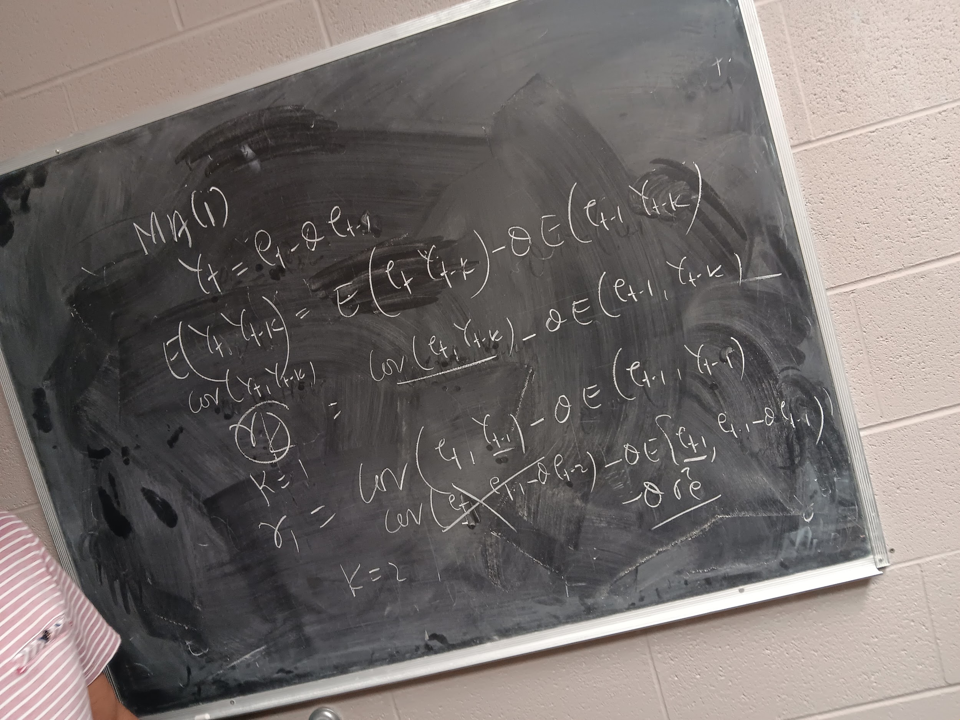

Time Series Forecasting - 4 Bedroom Houses
Cameron Carter, Maria Dodson, & Nazim Pacheco

Slide 2

Data Introduction
Forecasting home prices is always an important task for homebuyers & economists
Helps understand economic stability and assist people in financial decision making
Data obtained from Kaggle, Housing Property Sales Time Series by MtAG
Contains sale price info on bedrooms and apartments, of many bedroom sizes
Our focus is on 4 bedroom home prices:
The data was sorted by chronological order
Cleaned and trimmed to be only 4 bedrooms

Slide 3
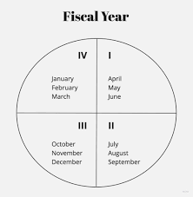
Data Details
Home sale prices measured every fiscal quarter from 2007 to 2019
Measured every fiscal quarter on March 31st, June 30th, September 30th, and December 31st: Total 51 observations, the data point for Dec. 2019 was missing.
Min. 1st Qu. Median Mean 3rd Qu. Max.
548,969 604,071 636,687 669,804 741,295 837,295

Slide 4
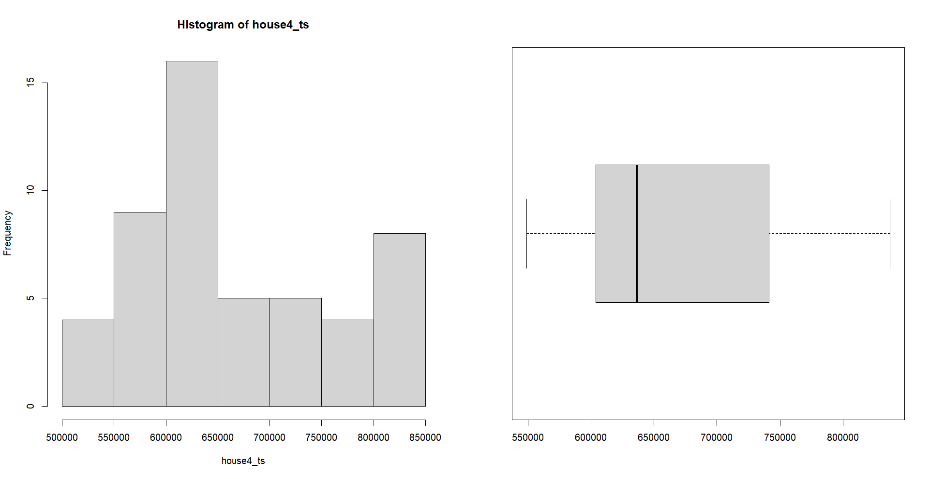
Data Details - Graphs

Slide 5
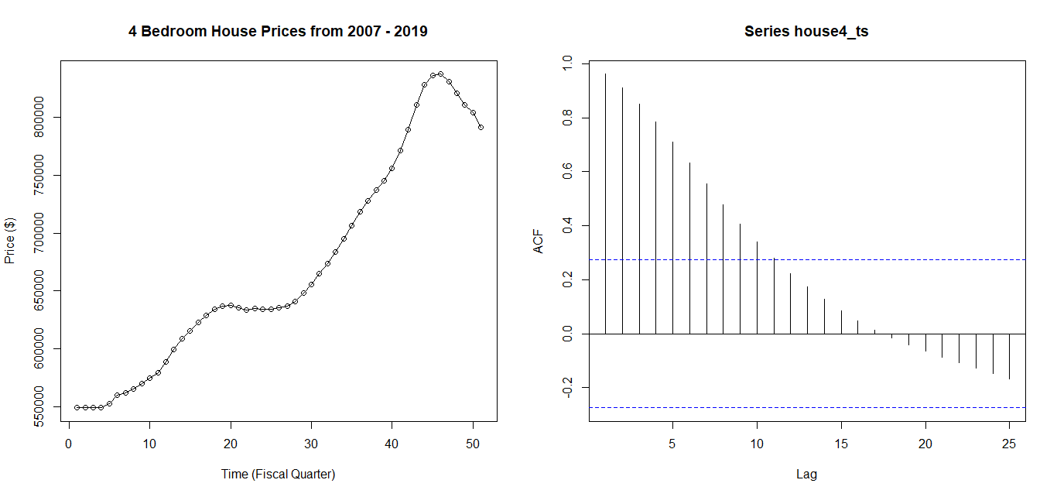
Our Time Series Plot for a 4 Bedroom House and the ACF
Non-constant Mean
Unstable Variance
Non-Stationary Behavior
Slowly Decaying ACF
Upward Trend
Requires Differencing
There must be a D value!

Slide 6
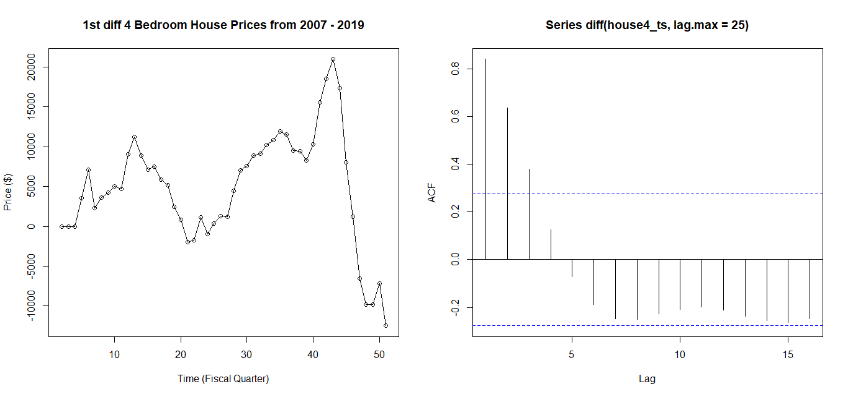
After 1st Differencing - ARIMA(p, 1, q)
Trend Reduced
Still Non-Stationary
Non-constant mean
Unstable Variance
Correlation Among Lags in ACF
1st differencing not enough
Cannot Use ACF/PACF/EACF Unless stationary!
We must perform a 2nd Differencing
Hence, d > 1 (For NOW)

Slide 7
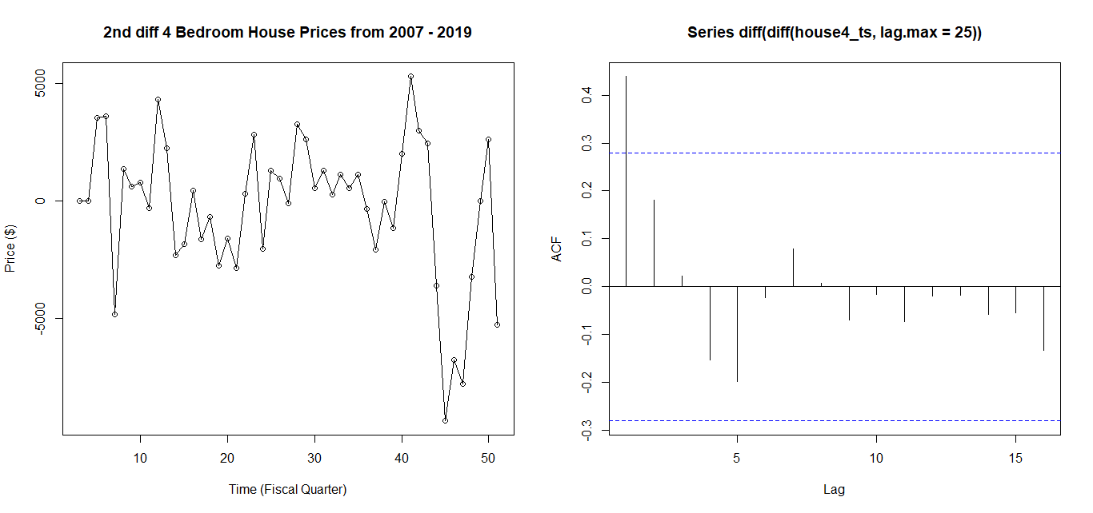
After 2nd Differencing - Finally Stationary
Constant Mean - zero
Stable Variance
Finally Stationary
One Bar above line in ACF
Trend Fully Removed
Can Now Use Tools
D is equivalent to 2 → Now Look for p and q

Slide 8
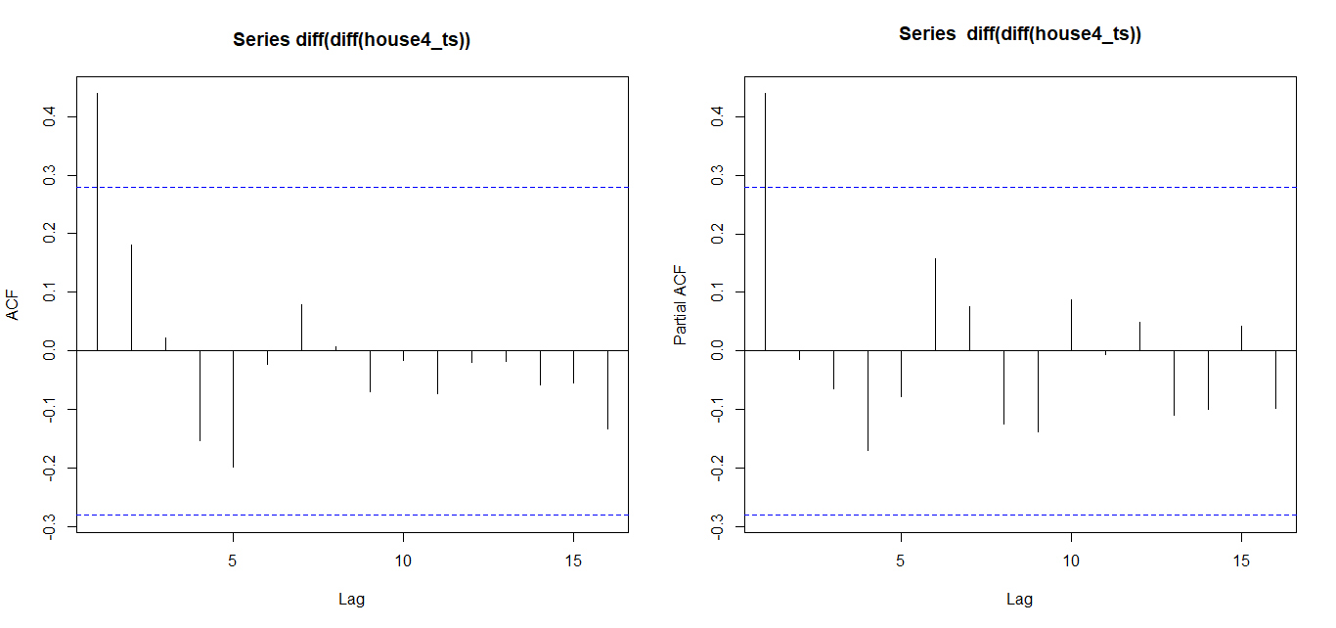
ACF/PACF/EACF
AR/MA
0 1 2 3 4 5 6 7 8 9 10 11 12 13
0 x o o o o o o o o o o o o o
1 o o o o o o o o o o o o o o
2 x o o o o o o o o o o o o o
3 o o o o o o o o o o o o o o
4 o x o o o o o o o o o o o o
5 o o o o o o o o o o o o o o
6 x x o o o o o o o o o o o o
7 x x o o o o o o o o o o o o
ACF: Tails off — PACF: Cuts off
Suggests AR(1) Process
EACF suggests both MA(1) & AR(1)

Slide 9
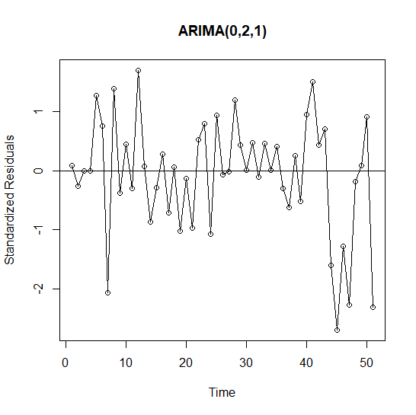
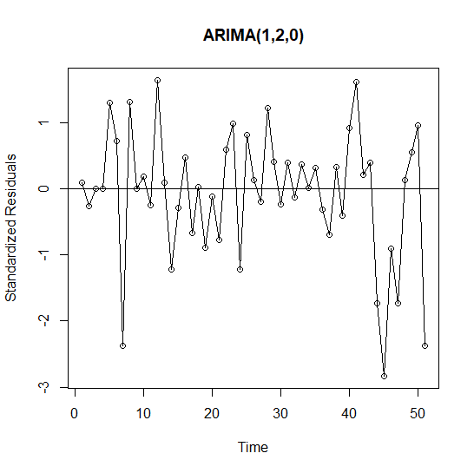
Standardized Residuals - Two Competing Models: ARIMA(0,2,1) & ARIMA(1,2,0)
No pattern, looks relatively stable, model captures data well.
No pattern, looks relatively stable, model captures data well.

Slide 10
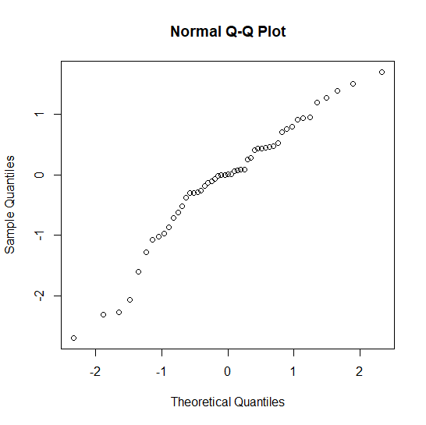
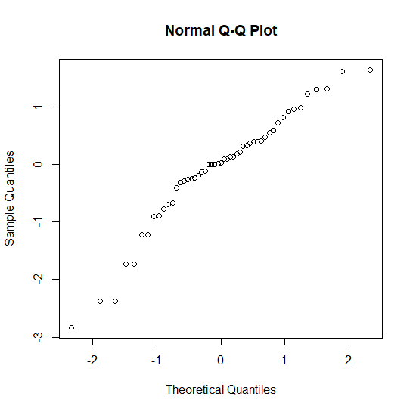
Testing for Normality - (QQ-Plots & Shapiro-Wilk Tests)
ARIMA(0,2,1)
ARIMA(1,2,0)
Shapiro-wilk:
Reject H0 → Not norm
P-value = 0.03863
Shapiro-Wilk
Reject H0 → Not norm
P-value: 0.01805

Slide 11
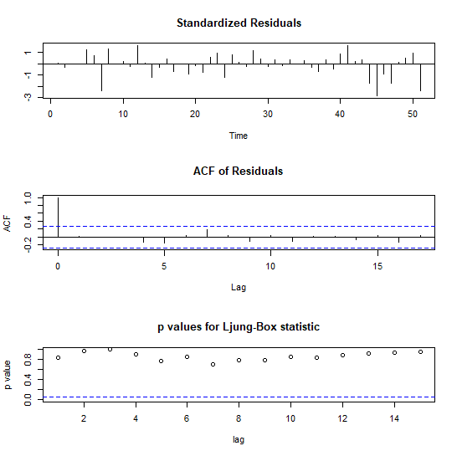
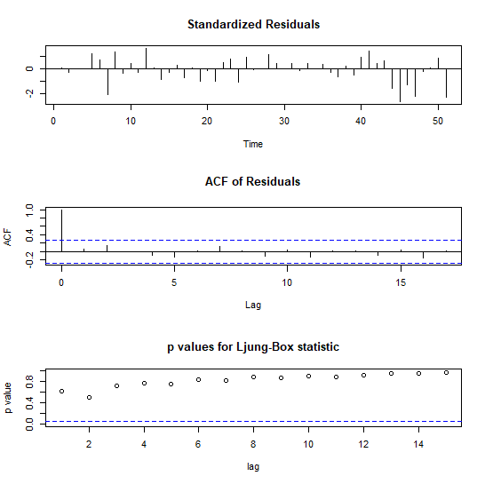
Residuals → Ljung-Box Test
ARIMA(1,2,0)
P-value > alpha → Fail to reject H0
Residuals are independent
ARIMA(0,2,1)
P-value > alpha → Fail to reject H0
Residuals are independent

Slide 12
Two Competing Models - ARIMA(0,2,1) & ARIMA(1,2,0)
⇒Residual Diagnostics
AIC/BIC:
Model | AIC | BIC
ARIMA(1,2,0) | 918.5358 | 922.3194
ARIMA(0,2,1) | 917.2989 | 921.0825
ARIMA(0,2,1) Shows lower AIC/BIC
OUR FINAL MODEL ⇒ ARIMA(0,2,1)

Slide 13
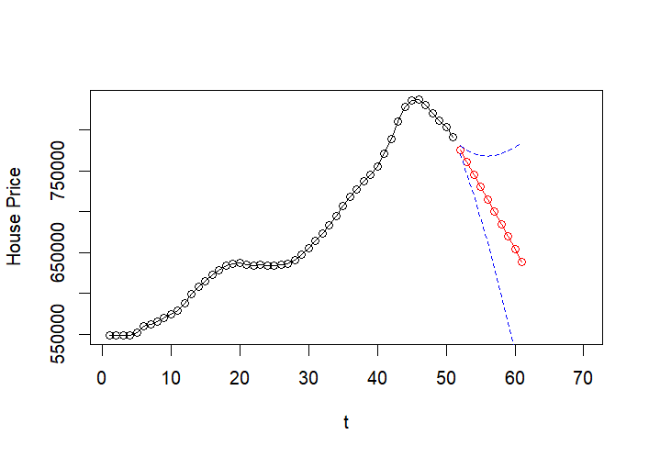
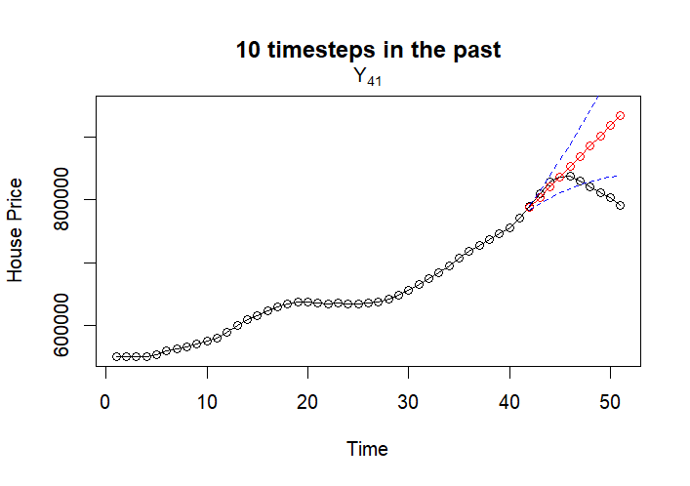
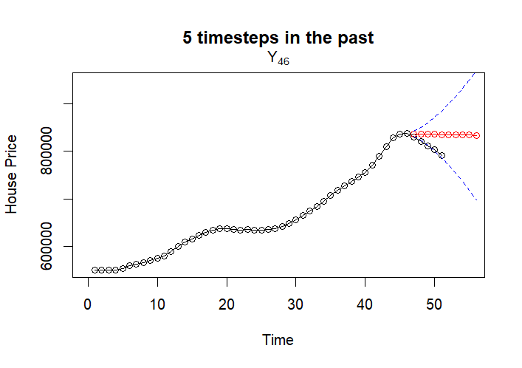
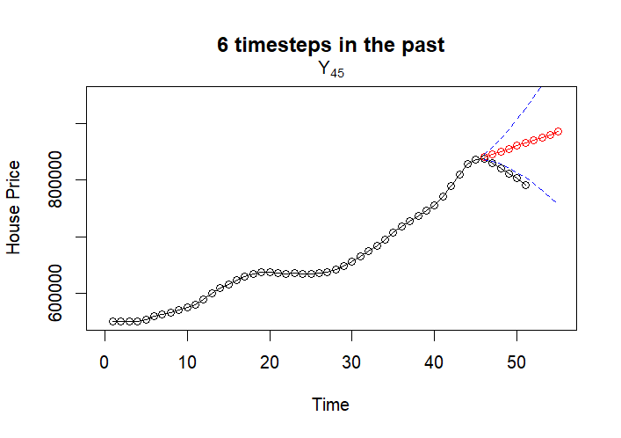
Forecasting From Various Yt
Likely external factor
Wide CI due to selecting MA process
Based on our forecast, there may have been a housing crash in this area
For consideration:
Only one significant lag
External factors not included
Notes:
Maria

Slide 14
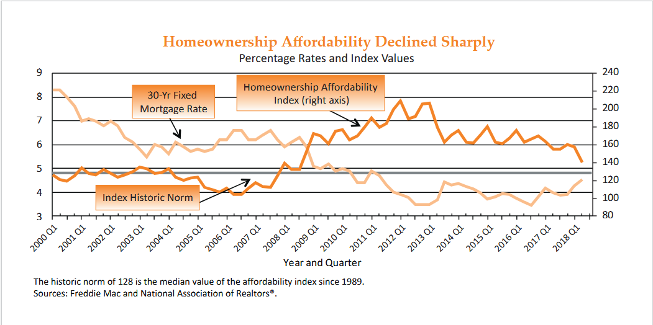
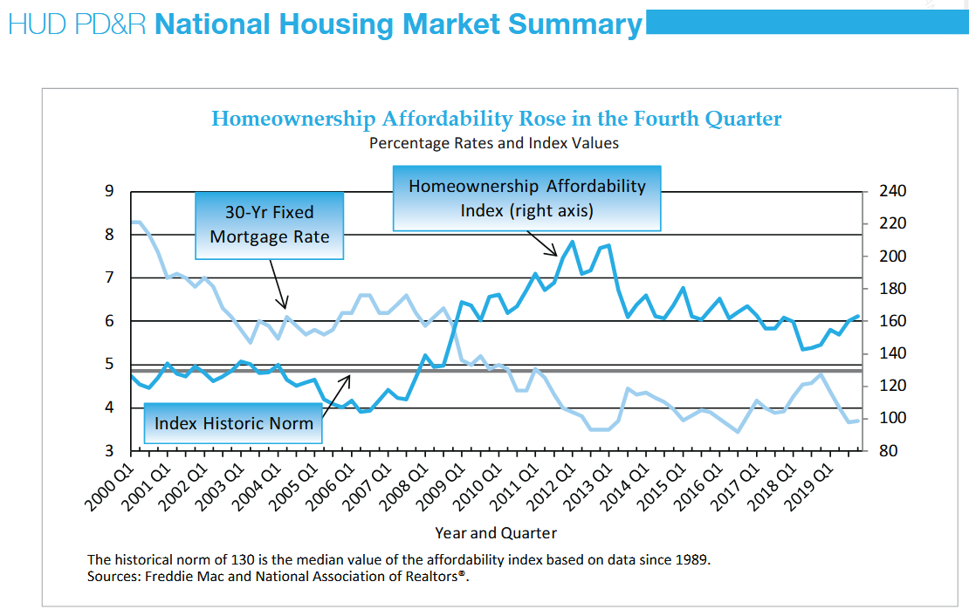
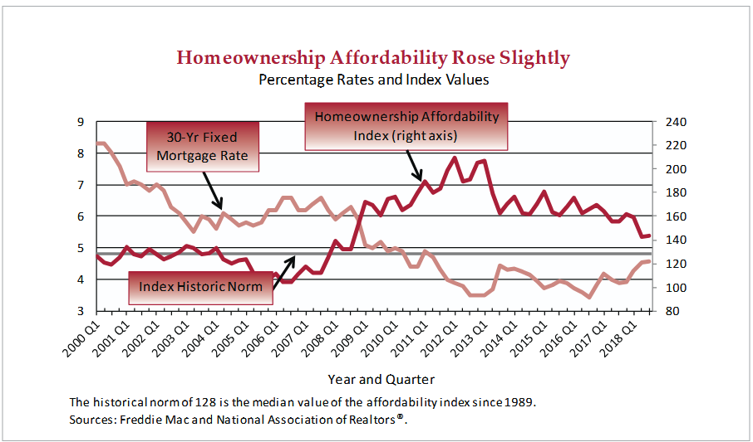
U.S. Department of Housing and Urban Development Reports
Q2 2018 Report
Q4 2019 Report
Corresponds with Y46 and Y47
Source: https://www.huduser.gov/portal/ushmc/quarterly_commentary.html
Q3 2018 Report

Slide 15
Summary and Closing Remarks
Data: price of 4 bedroom homes at each fiscal quarter, 2007 to 2019; Stochastic, near enough to stationary after differencing
Two models were the best contenders: ARI(1,2) and IMA(2,1)
After a variety of tests to analyze their benefits, IMA(2,1) was selected as the best fit for this series
A forecast was created for 10 timesteps into the future and its limitations were discussed
Decline from Y47 to the end of the time series discussed
Notes:
Maria

